Slide 1







Learn4All:
Inclusive Learning Progress & Resource Planner
A Python Application for that suggest study material to student according to their weak topic
BY TEAM NO 13

Slide 2






The Challenge & SDG Relevance
Many students struggle with learning gaps and lack access to personalized study support, deepening educational inequality.
SDG 4
SDG 10
QUALITY EDUCATION
REDUCED INEQUALITIES
Ensure inclusive and equitable quality education for all.
Reduce disparities in educational resources and support.

Slide 3

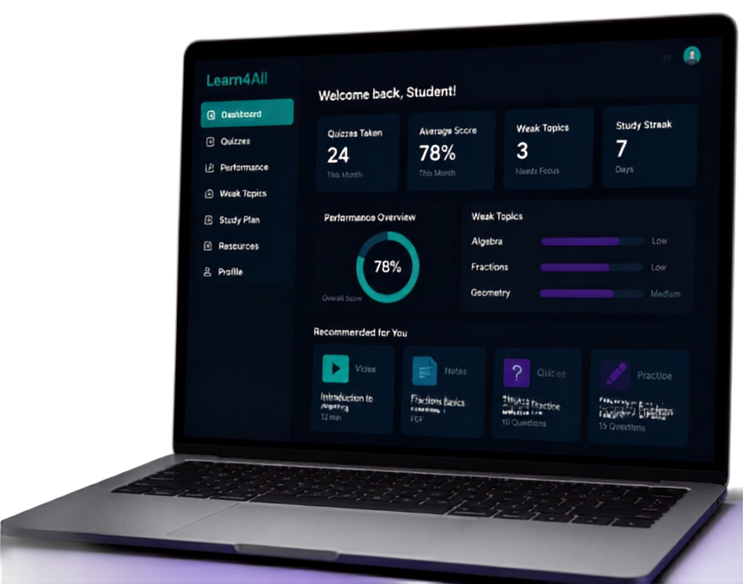
Our Solution – Learn4All Application
Python-powered platform for Classes 1–10
Take quizzes and assess your knowledge
AI evaluates performance and spots weak topics
Personalized study path with videos, notes, quizzes and practice tasks
Topic-specific recommendations for inclusive and focused learning

Slide 4












System Architecture & Workflow
A modular Python application that evaluates, analyzes, and guides every learner toward stronger understanding.
CORE MODULES
STUDENT
SUBJECT
ASSESSMENT
RESOURCE
QUIZ
PERFORMANCE EVALUATION
WEAK TOPIC IDENTIFICATION
RESOURCE RECOMMENDATION
REPORT GENERATION
Data flows across modules to deliver insights,
personalized guidance, and measurable improvement.

Slide 5













Key Features of
Learn4All
01
Multi-class support for Classes 1-10
02
Automatic performance calculation and progress tracking
03
Identify strengths and weaknesses by topic
04
Personalized recommendations with multiple resource types
05
Generate individual learner reports and class-level summaries

Slide 6








Object-Oriented Programming
Student
id
name
grade
Implementation
take_quiz()
view_performance()
get recommendations()
Assessment
id
type
score
date
Core classes model the key entities in the application
Encapsulated data and methods ensure modularity and scalability
Inheritance and composition build flexible relationships
Clean structure that’s easy
to extend and maintain
evaluate()
analyze()
Subject
Resource
id
title
description
id
title
url
type
get_topics()
add_topic()
get_details()
preview()

Slide 7

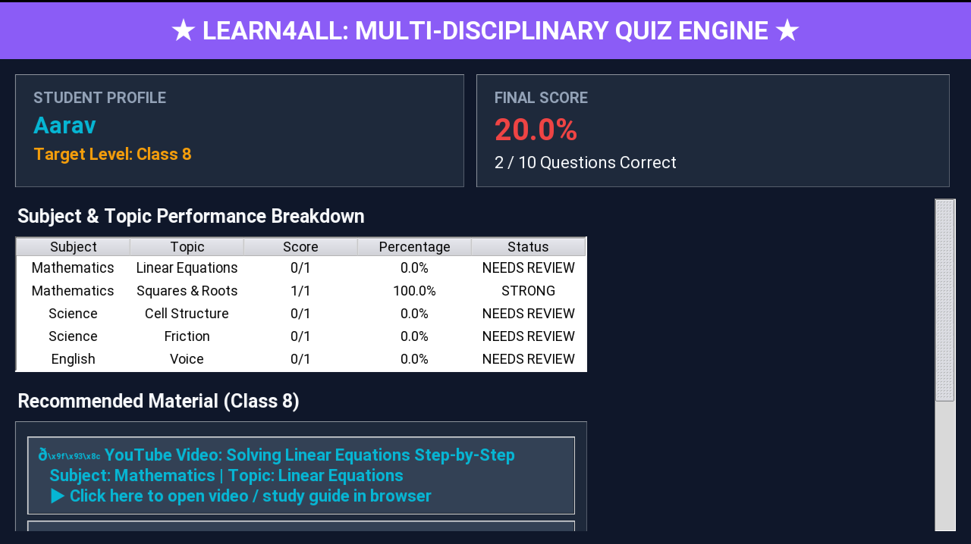
Demo & Representative
Results
A prototype demo using test data to show how the app works.
Quiz performances with score breakdown
Weak topics identified with focus areas
Personalized resource recommendations
Learner progress report snapshot
45%

Slide 8

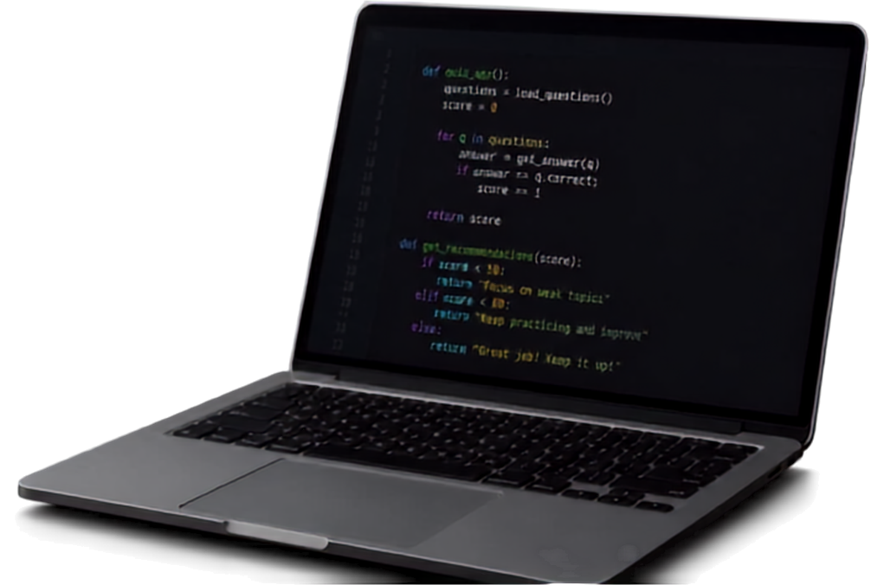



Sources
Tools and platforms that supported this project
Internet research
Exploring different sources online
ChatGPT
Breaking down problems and generating solutions
Gemini & Claude
Verifying, improving, and refining the code
Canva
Designing visuals and creating this presentation

